Slide 1
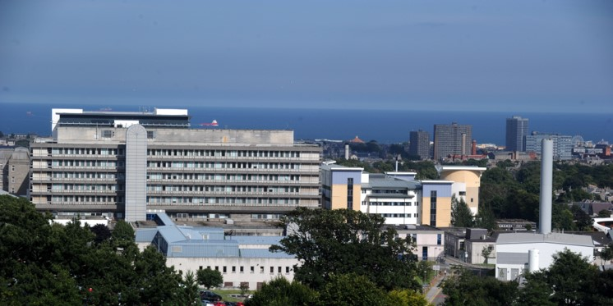
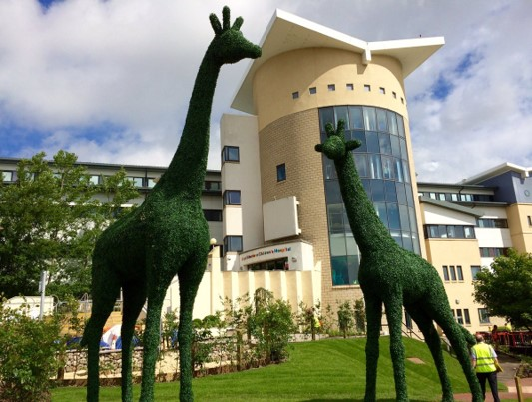
Interprofessional Working
A Practical Perspective
Peter Bodkin
Consultant Neurosurgeon
Aberdeen Royal Infirmary

Slide 3
 | Monday | Tuesday | Wednesday | Thursday | Friday | Weekend
8.00-9.00 | Handover/ Board round | Handover/ Board round | Handover/ Board round | Spine MDT | Handover/ Board round
9.00-13.00 | Clinic | Theatre | Clinic | Neuro-oncology MDT | Management meeting or Inverness clinic
13.00-14.00
14.00-18.00 | Teaching | Theatre | Admin | Theatre | Inverness clinic

Slide 5
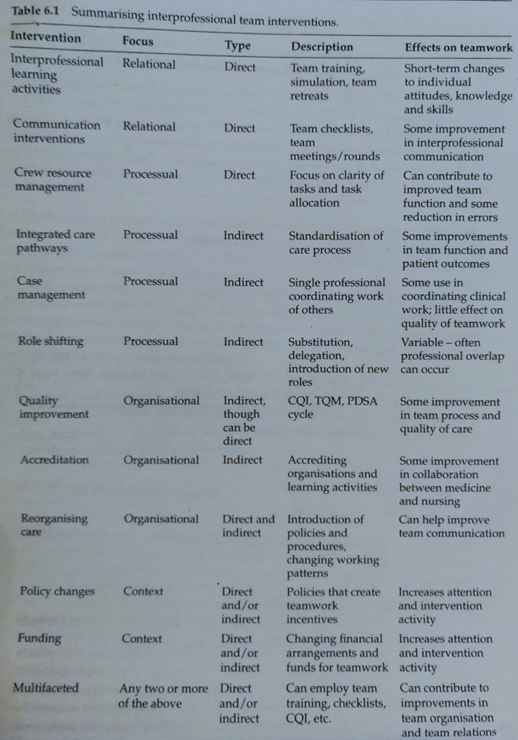
Educational/ practice/organisational interventions
Relational/ processual/ organisational/ contextual
Direct/ indirect

Slide 6
Patient journey – Mr S

Slide 8
Handover
8-8.30am meeting
Led by neurosurgical registrar
Attended by neurosurgical consultants/registrars/juniors, nurses, flow co-ordinator, AHPs, pharmacist, students
Plans made for referred patients
8.30 meeting going through inpatients
Interprofessional team intervention:
Communication intervention, crew resource management, case management
Interprofessional learning
Outcome for Mr S: admit for MRI, discuss at MDT, consider awake craniotomy

Slide 9
Side track
Focus on scans
Doctor led
Busy time – admissions to clerk in, surgical brief to attend (8.20),
Outcomes not recorded

Slide 10
Neuro-oncology MDT
Weekly meeting every Thursday
Led by neuroradiologist
Telelink with neuropathologist in Edinburgh
Also attended by neurosurgeons, trainees, neuro-oncology nurse
Interprofessional team intervention:
Communication intervention, crew resource management, case management
Interprofessional learning
Outcome for Mr S: offer awake craniotomy with motor and speech monitoring

Slide 11
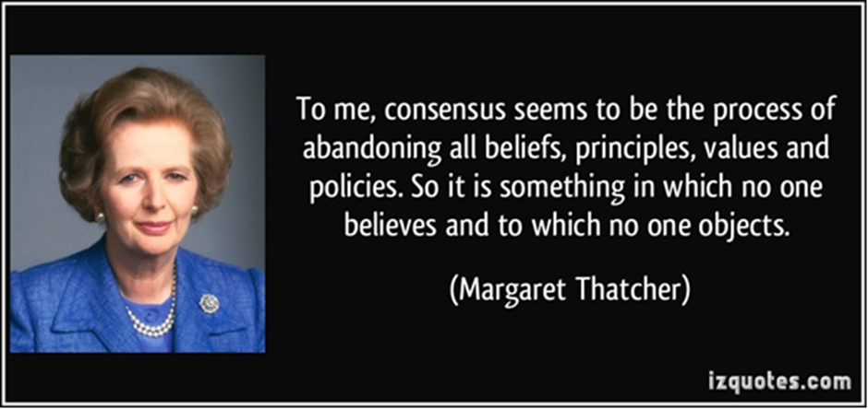
May not have time to wait for MDT depending on day referred
Scan focussed not patient focussed
Clinical information sometimes lacking
Doctor led
Side tracking

Slide 12
2006 National Institute for Health and Clinical Excellence (NICE) guidelines advise referral of any suspected brain tumour to a dedicated neuro-oncology MDT
Scottish Adult Neuro-oncology Network (SANON) – Quality Performance Indicators
Interprofessional team intervention:
Integrated care pathways, quality improvement, accreditation, reorganising care

Slide 14
Awake Craniotomy Surgery
Started in 2010 in Aberdeen
Preceded by team visit to course in Dusseldorf – neurosurgeons, anaesthetists, speech and language therapists, scrub nurses, neurophysiologist
Interprofessional team intervention:
Interprofessional learning activities

Slide 15
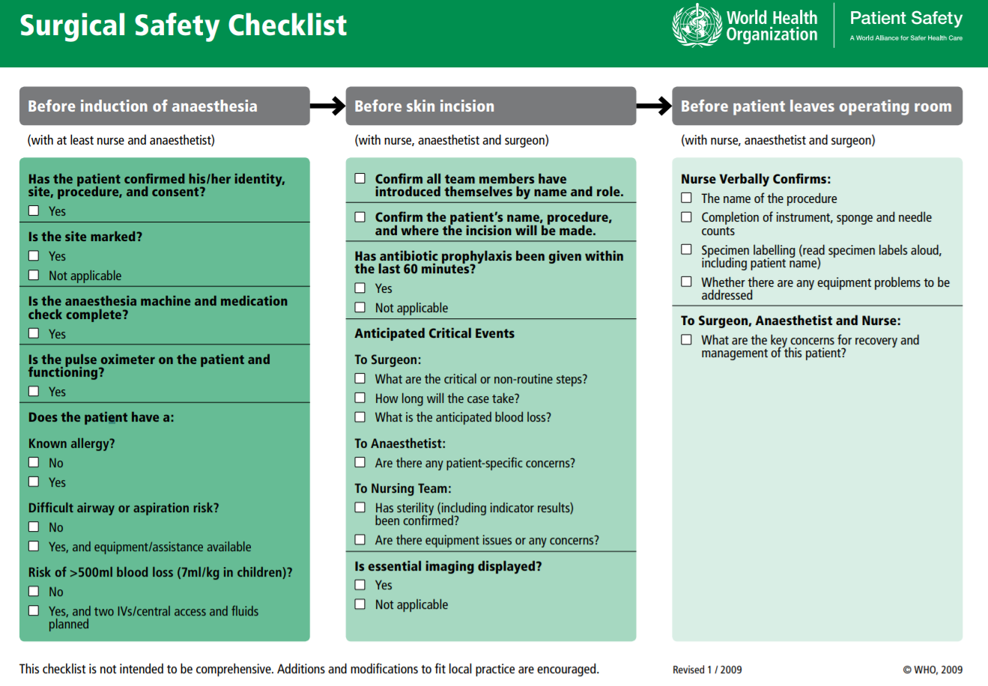
WHO Surgical Checklist
Interprofessional team intervention:
Communication intervention

Slide 16
Haynes et al NEJM 2009 360:491-9
19 item surgical check list
Eight hospitals in eight cities – Toronto, New Dehli, Amman, Auckland, Manila, Ifakara, London, Seattle
Death rate dropped from 1.5% to 0.8%
Inpatient complications dropped from 11% to 7%
National Patient Safety Agency in UK stated that 26 point checklist to be instituted in all NHS hospitals by 2010

Slide 17
Before attending medical school, I was a fighter pilot flying F-86 Sabrejets in the Air Force.
I and most of my flying colleagues always used checklists that were strapped to our thighs while we were sitting in the cockpit.
Every one of the myriad switches, gauges, dials, handles, and circuit breakers had to be properly set or checked.
Procedures had to be followed assiduously, especially during an emergency. Checklists helped us do that.
Each of us knew that a careless mistake could lead to our death.
By contrast, if physicians or nurses make a careless mistake, someone else suffers or dies….
David C Levin

Slide 18
Hawthorne effect – teams improved because of their awareness of being studied
Time out after induction of anaesthesia extends anaesthetic time and may lead to hyperthermia, etc.
Preintervention rate of death exceeded the published normal range of 0.4 to 0.8%

Slide 19
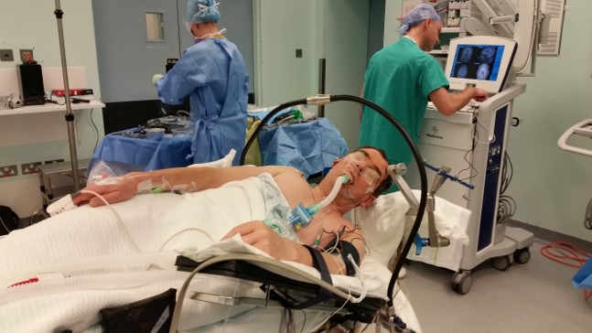

Slide 20
Anaesthetist – asleep/awake/asleep, scalp block
Nursing – positioning, instruments
Neurosurgery– image guidance, surgical planning
Neurophysiology – cortical mapping
Speech and language – appropriate batteries of tests

Slide 21
Post-op
Patient discussed at daily ‘board round’
Daily ward round
Input from speech and language therapy/physio – rehab goals
Flow coordinator organised transfer back to Orkney for recuperation
Discharge letter
Discussed again in Neuro-oncology MDT – pathology, post-op imaging
Arrangements made for chemotherapy and radiotherapy under neuro-oncology

Slide 22
Challenges
Intervention design often intuitive rather than evidence based
Lack of measurement of impact of intervention
Opinion of patients/relatives rarely taken into account
Interventions rarely tackle ‘higher order’ (structural) problems such as imbalances in interprofessional relations and inequalities in power
‘By directing attention towards the need for an educational solution to greater service co-ordination, it also diverts discussion from the appropriateness or not of existing professional [……] boundaries.’
Funnel 1995

Slide 23
